Slide 1
Crop Protection Contributions
toward Agricultural Productivity
A paper in the series on The Need for Agricultural Innovation to Sustainably Feed the World by 2050
CAST ISSUE PAPER 58, APRIL 2017
Susan T. Ratcliffe (Chair), North Central IPM Center, University of Illinois, Urbana
Matthew Baur, Western IPM Center, University of California, Davis
Hugh J. Beckie, Science and Tech. Branch, Agric. and Agri-Food Canada, Saskatoon
Loren J. Giesler, Department of Plant Pathology, University of Nebraska, Lincoln
Norman C. Leppla, Entomology and Nematology Dept., Univ. of Florida, Gainesville
Jill Schroeder, Office of Pest Management Policy, USDA, Washington, D.C.

Slide 2
Council for Agricultural Science and Technology
CAST, through its network of experts, assembles, interprets, and communicates credible, balanced, science-based information to policymakers, the media, the private sector, and the public.
“…what CAST does is very important to mankind.”
~Dr. Norman E. Borlaug

Slide 3
Ag Innovation Series: 10 Issue Papers
The Need for Agricultural Innovation to
Sustainably Feed the World by 2050:
“How will we feed nine+ billion people?”
CAST created this series to look at specific programs, policies, and technologies that will advance global food security.
Focus on the role of agriculture/food science and technology to close the expected productivity gap.
Spur interests in research funding and highlight societal benefits of new and emerging technologies.
Encourage the implementation and use of science-based regulation to support innovation and the advancement of agriculture/food technology.

Slide 4
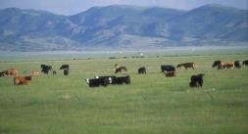
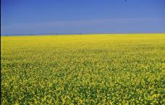
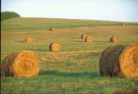
Goals and Objectives of this Paper
Assess the impact of crop protection technologies on production.
Review current and future crop protection technologies.
Describe crop protection for the future.

Slide 5
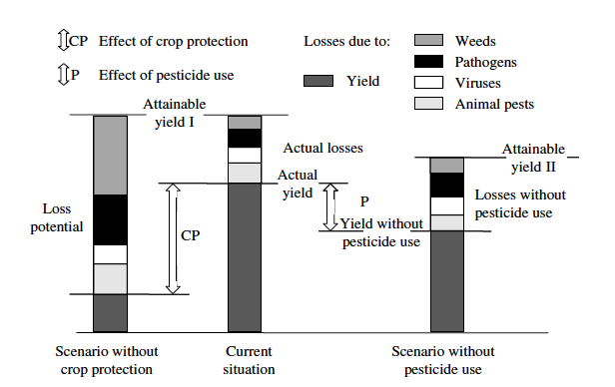
Impact of Crop Protection Technologies on Production
Oerke 2006

Slide 6
Crop Protection Technology Effectiveness
Average efficacy of pest control practices worldwide in reducing loss potential of pathogens, viruses, animal pests, and weeds, respectively (reduction rates calculated from estimates of monetary production losses in barley, cottonseed, maize, oilseed rape, potatoes, rice, soybean, cotton, sugar beet, tomatoes and wheat in 2001–03 (Oerke 2006).

Slide 7
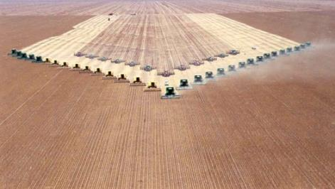
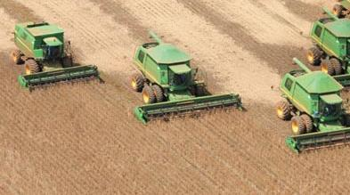
Current and Future Production Systems
Central and northeastern regions of Brazil.
J.R.P. Parra, ESALQ, Entomologia e Acarologia

Slide 8
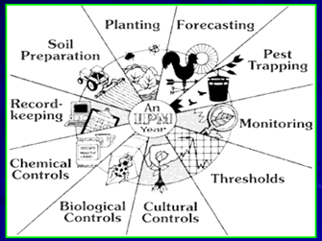
Current and Future Crop Protection Technologies

Slide 9
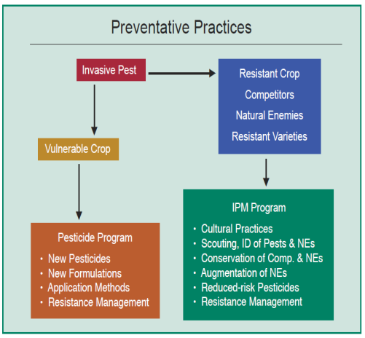
Pest Prevention Based on Pesticides or IPM
Pesticide-induced vulnerable crop
Increased long-term costs
Increased pest resistance
Increased human exposure
Increased environmental risks
Resistant crop maintained by IPM
Human health and environmental benefits
Prolonged efficacy of tools

Slide 10
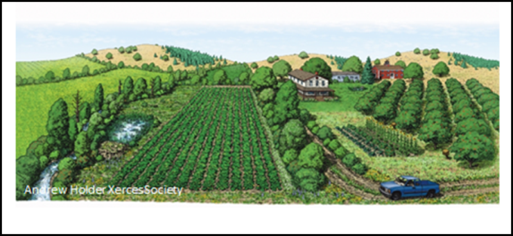
Integrated pest management (IPM) is “a sustainable approach to managing pests by combining biological, cultural, physical, and chemical tools in a way that minimizes economic, health, and environmental risks” (Food, Conservation, and Energy Act of 2008, i.e. Farm Bill).
Integrated Pest Management

Slide 11
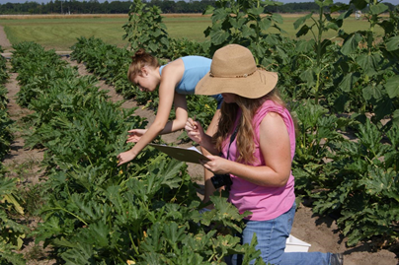
IPM focuses on pest prevention and uses monitoring, recordkeeping, and economic thresholds to make management decisions.
Scouting for insect pests.
Norm Leppla, University of Florida

Slide 12
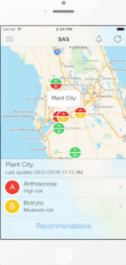
However, there are limitations to using thresholds for making management decisions.
Weed thresholds have limitations because one plant can produce over 100,000 seeds. Management decisions should be based on yearly mapping and regular scouting (Joseph LaForest, UGA, Bugwood.org).
Palmer Amaranth seed head
Predictive equations based on temperature and leaf wetness duration are used to time fungicide applications for anthracnose and Botrytis strawberry fruit rot (Web-based Strawberry Advisory System (Pavan et al. 2017).

Slide 13
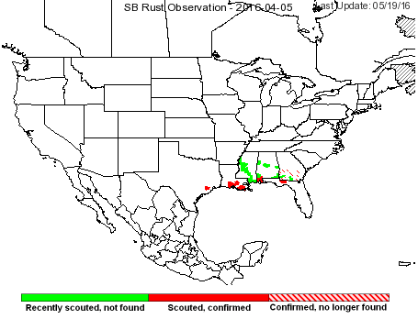
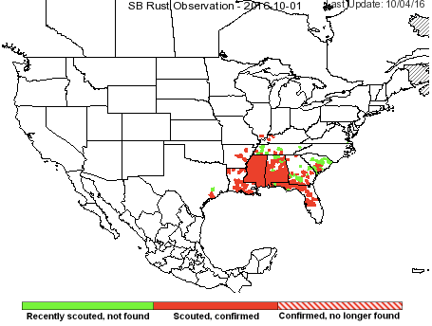
Scouting provides data for
GIS-based real-time mapping.
Soybean rust, Integrated Pest Management – Pest Information Platform for Extension and Education (ipmPIPE) (UGA Center for Invasive Species and Ecosystem Health).
Drone scouting field in North Dakota.
North Dakota State University
Notes:
Makes monitoring for pests easier and faster resulting in more informed management decisions. Two images from the ipmPIPE illustrate the spread of soybean rust beginning on April 5, 2016 and the distribution of the pathogen by October 1, 2016.

Slide 14
Improvements are being made in pest surveillance and diagnostics.
USDA, APHIS, PPQ Biological Scientist Terrence Walters leads a workshop on pest identification software for a Rutgers University Course called "Plant Biosecurity Issues and Technologies."

Slide 15
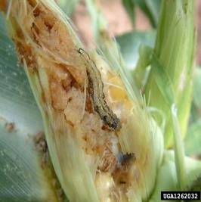
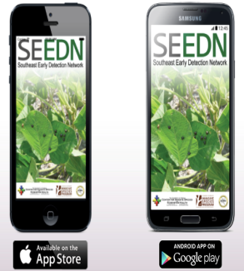
Distance diagnostics and apps are being used for early detection of established and alien invasive species.
National Plant Diagnostic Network
Old world bollworm
(Helicoverpa armigera)
The Southeast Early Detection Network (SEEDN), an invasive species reporting, verification and notification system (UGA Center for Invasive Species and Ecosystem Health).
Notes:
Pest identification can be a biosecurity, many alien invasive species, old world bollworm can be mistaken for existing pest populations such as the corn earworm

Slide 16
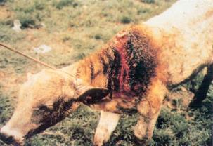
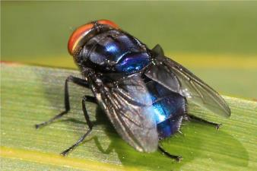
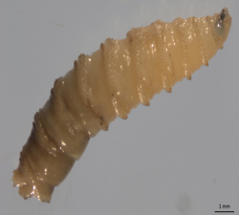
Regulatory pest management methods include port inspection, pest exclusion, quarantine, eradication, and area-wide management.
Screwworm fly, Cochliomyia hominivorax (Coquerel).
Judy Gallagher
Sterile male marked to study dispersal.
Peggy Greb, USDA, ARS
Screwworm larva. Heather Stockdale, Walden, UF
Notes:
USDA’s Animal and Plant Health Inspection Service (APHIS)is announcing the successful eradication of the New World screwworm (NWS) from Florida.
“I want to personally thank our many collaborating partners at the Federal, State, and local levels,” said Dr. Jack Shere, USDA Chief Veterinarian. “Through their dedication and professionalism close to 154 million sterile flies have been released, 16,902 animals have been inspected at checkpoints, and almost 430 hours of active surveillance in the Keys and 250 hours of active surveillance on the mainland have been completed. Their tireless work has allowed us to eliminate New World screwworm from the United States once again.”
Animal health checkpoints, or interdiction stations, were closed on Saturday. The last sterile fly releases in Homestead, FL took place on Tuesday and fly releases are scheduled to end on April 25 in the Florida Keys.

Slide 17
Plant breeders are developing new resistant cultivars and crops are being grow on suitable land.
Asian citrus psyllid, Diaphorina citri. Jeffrey Lotz, Florida Dept. of Agriculture and Consumer Services, Bugwood.org
Citrus greening damage.
H.D. Catling, Bugwood.org
Notes:
Removal of surrounding alternative host plants of Asian citrus psyllid

Slide 18
Crops are managed increasingly through rotation, improving tillage, optimizing planting and harvesting dates, implementing BMPs (fertilization, irrigation), minimizing inputs, and conserving natural enemies.

Slide 19
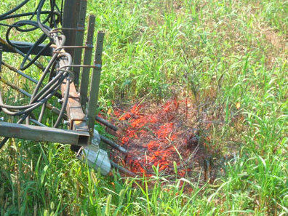
Weed management includes robotics, flaming, tillage, traps, barriers, mulches, and plasticulture.
Tractor-mounted system for spraying corn grit to shred the leaves of weeds growing between crop rows. Dean Peterson (D3204-1)
Flaming weeds. University
of Nebraska - Lincoln

Slide 20
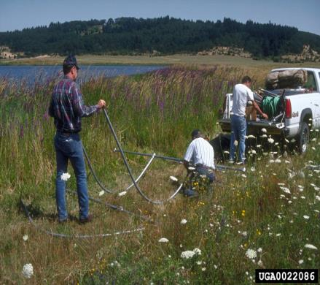
Use of biopesticides, endoparasites, parasitoids, predators, and herbivores is increasing.
Purple loosestrife before release of golden loosestrife beetle, Galerucella pusilla. Eric Coombs, Oregon Dept. of Agriculture, Bugwood.org
Tomato hornworm covered with
braconid wasp pupae. S. T. Ratcliffe

Slide 21
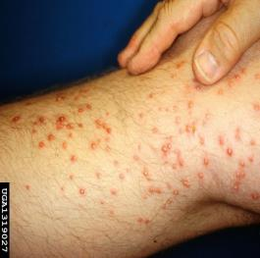
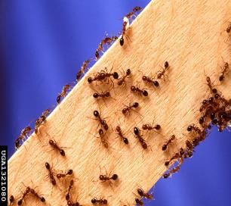
Pesticides are being developed with new modes of action and improved formulations, e.g., baits.
Researcher stung over 250 times on one leg when he knelt on a fire ant mound.
Daniel Wojcik, USDA, ARS, Bugwood.org
Imported fire ant, Solenopsis invicta Buren. Scott Bauer,
USDA ARS, Bugwood.org
Imported fire ant mounds in pasture. Imported Fire Ant Station, USDA, APHIS PPQ, Bugwood.org
Notes:
In less than 10 seconds, an unwary scientist was stung over 250 times on one leg when he carelessly knelt on a collapsed fire ant mound. The sterile pustules developed to this stage in 3 days.

Slide 22
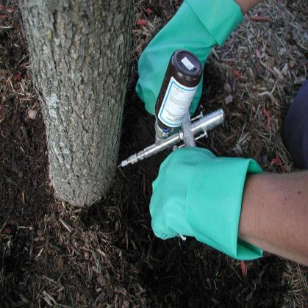
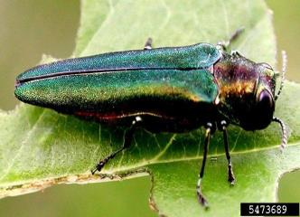
There are new insecticide seed treatments and injection methods.
Fungicide treated rice seed. Donald Groth, LSU AgCenter, Bugwood.org
Emerald ash borer
adult. Leah Bauer,
USDA, Forest Service,
Northern Research
Station, Bugwood.org
R.L. Croissant,
Bugwood.org

Slide 23
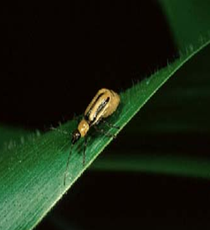
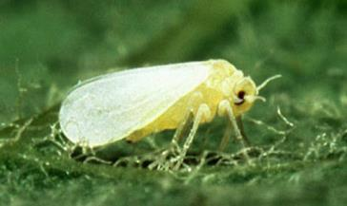
RNAi, CRISPR-Cas9, and rapid sequencing are being developed for pest management.
Western corn rootworm, Diabrotica virgifera virgifera LeConte. University of Illinois
Aedes aegypti Linnaeus.
Sweetpotato whitefly, Bemisia tabaci (Gennadius). Scott Bauer, USDA, ARS
Notes:
OX513A is a self-limiting strain of the Aedes aegypti mosquito. Males, which do not bite or transmit disease, are released to mate with wild females. The offspring of such matings die before becoming adults. With repeated releases of sufficient numbers of these self-limiting males, there is a reduction in the wild population to below the level needed to transmit disease according to models of disease transmission.
Before release, male and female pupae are separated mechanically, exploiting the fact that naturally they are significantly different in size. The strain also contains a fluorescent marker, termed DsRed, which is a useful tool for quality control in production and effective monitoring in the field.

Slide 24
Crop Protection for the Future
Employ crop advisors- IPM delivery, IPM plans (whole farm, agroecology), complex education and training (DPM & DPH).
Increase adoption of IPM by growers
Improve the use of pesticides- application methods, baits, seed treatments, site-specific smart technology (spot treatment), incorporate pesticides in IPM.
Develop new more selective pesticides- minimize non-target effects, target site or mode of action.
Preserve pesticides- resistance management, enforce label requirements (no off-label use).
Develop more biological control agents and biopesticides
Produce new pest resistant plants- breed cultivars, grafting.

Slide 25
Crop Protection for the Future
Create new genomic and molecular tools- RNAi, CRISPR-Cas9, rapid sequencing.
Advance mechanization- partial or total, guest farm workers.
Increase international agricultural trade- foreign produce, prevent introduction of alien invasive species.
Improve pest surveillance (detection) and diagnostics- attractants, traps, alert systems, apps.
Expand pest monitoring- scouting, drones, mapping (ipmPIPE), forecasting models.
Institute areawide pest management and eradication
Assure food safety- pathogens, pesticide residues.
Provide food security- increase innovation and sustainable production.

Slide 26
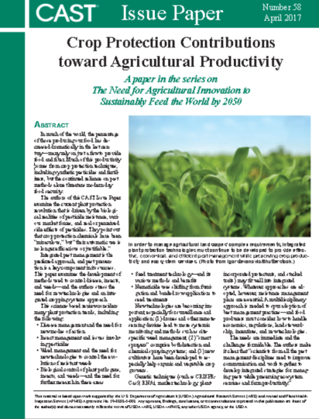
Questions/Discussion
Norm Leppla
ncleppla@ufl.edu
For a free download of Issue Paper 58,
visit the CAST website
www.cast-science.org.

